Slide 1

UNIX - Fundamentals
7
Simple Filters
9
SED
5
The shell
cmp comm diff head and tail …
Inserting
Updating
Deleting
RegEx….
1
UNIX Intro
3
Unix File System
Pattern matching
Escaping Redirecting…
The UNIX OS
The Linux OS
Features of Unix
The file
pwd and cd
mkdir
ls and cp ..
Shell Programming
8
GREP
10
6
The Processes
The character class
The *
The Dot…
condition eval
loops
read
exit status
4
Vi/Vim editors
ps nohup at and batch
2
Unix Commands
Input mode
Saving text
Aborting…
command basics
man
echo
printf …
Biz Nigatu
Software Engineer and Instructor
reckonedforce.com
@bizNigatu

Slide 2
Section 0 – UNIX Fundamentals
Course Introduction
Ubuntu Installation
Oracle VirtualBox Installation
Sharing Windows Folder

Slide 3
Welcome to CS126 UNIX Fundamentals

Slide 4

Introduction
Instructor: Biz Nigatu
Office Hours: 7:30 PM - 8:15 PM (Room 415) M/W
Textbook: Introduction to UNIX/Linux: The Ultimate Guide, 3rd Edition, Sumitabha Das, 2013
Class: CS126: UNIX Fundamentals
Times: 5:30 PM - 7:30 PM Monday and Wednesday
Room: Room 415

Slide 5
Structure of Class
Grades will come from:
Lab work
Attendance
Mid-term
Final
Mid-term and final will be taken in class

Slide 6
LAB 0 Ubuntu Installation and Root Password Install

Slide 7
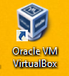
Oracle VirtualBox
You will install/run/use Ubuntu through VirtualBox
Double-click on the VirtualBox icon on your desktop:

Slide 8
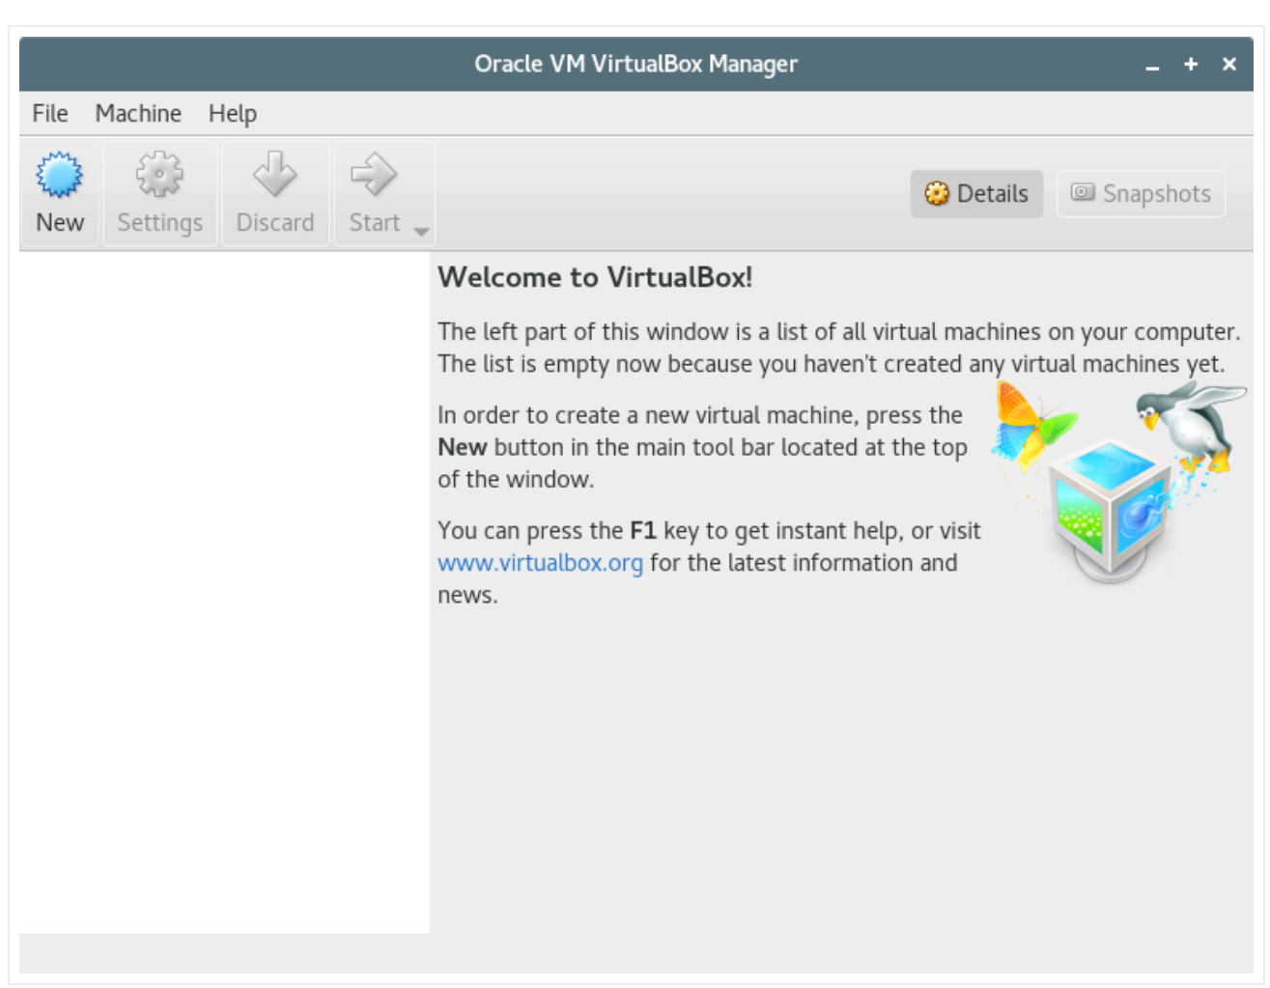
Install Ubuntu
Select ‘New’

Slide 9
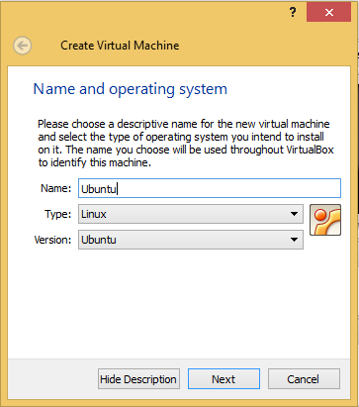
Ubuntu Installation
Enter in a name – if you enter in ‘Ubuntu’ then Linux will automatically be chosen for type and version will be Ubuntu

Slide 10
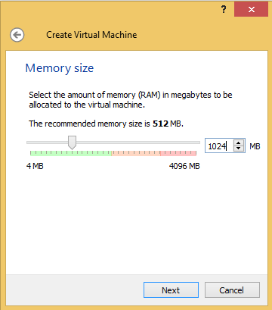
Storage on Physical Hard Disk
Accept default

Slide 11
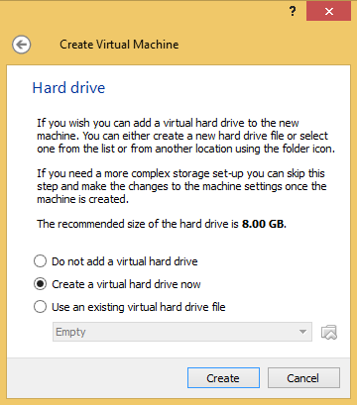
Hard Drive

Slide 12
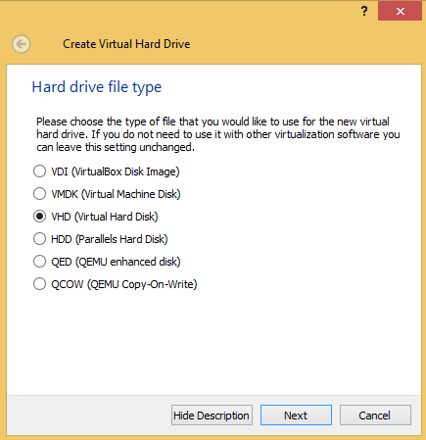
Setting Up Hard Disk

Slide 13
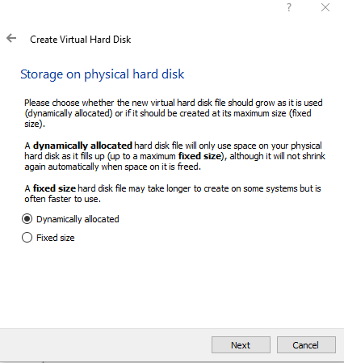
Setting Up Hard Disk File Type
Accept the default which is ‘Dynamically allocated’.
The default will only consume the space it needs.
It will not, however, go back, e.g. if you allocate 10GB and use 7GB then you won’t go back to, say, 6GB.

Slide 14
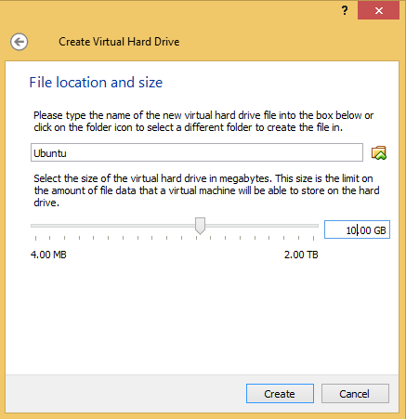
Make Drive 10 GB
1. Change to 10 GB
Click on ‘Create’
This could take a while…

Slide 15
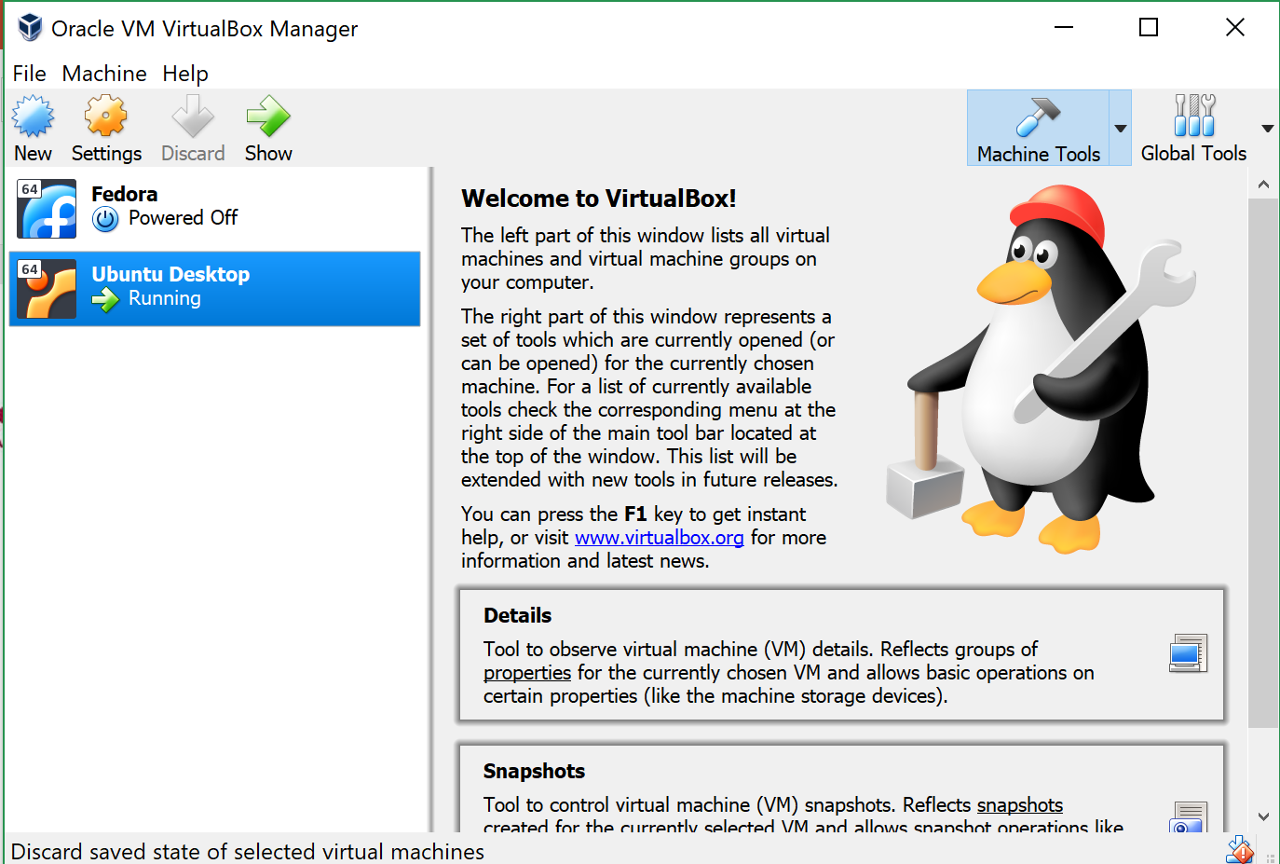
Settings

Slide 16
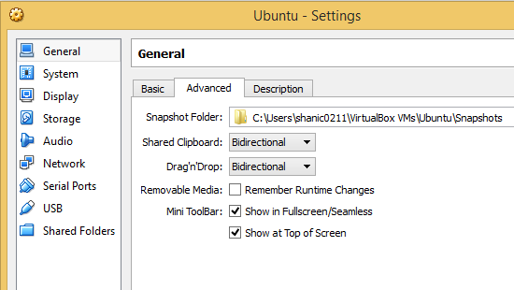
General Settings
Change these to ‘Bidirectional IF you’re installing on your home computer. You do not need this in the lab.

Slide 17
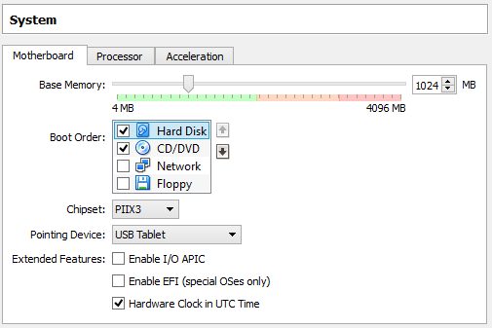
System Settings
Move ‘Floppy’ down and move ‘Hard Disk’ to the top

Slide 18
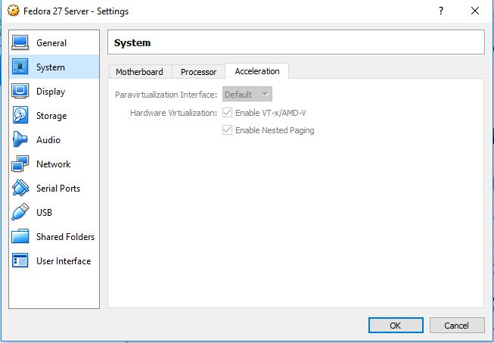
System Settings
Both should be checked – the first enables hardware virtualization

Slide 19
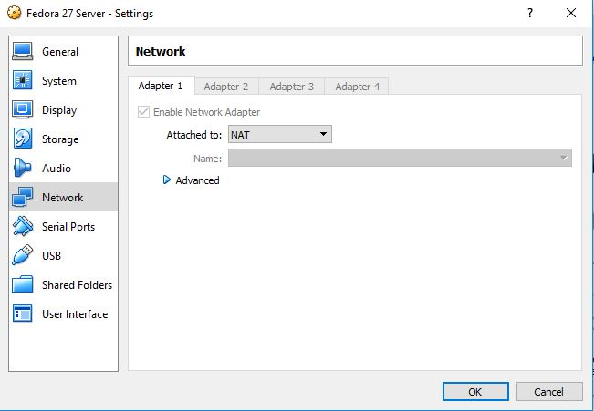
Settings - Network
Should be ‘NAT’

Slide 20
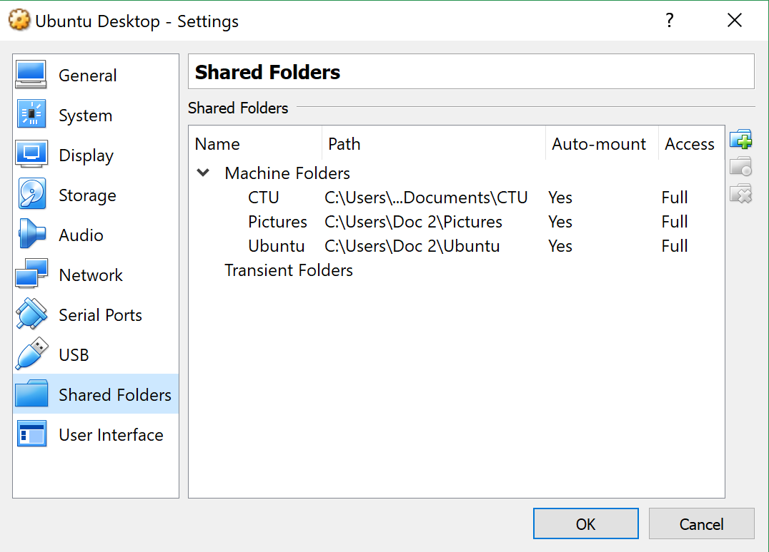
Shared Folders
Add Windows folders
This is for HOME installations ONLY

Slide 21
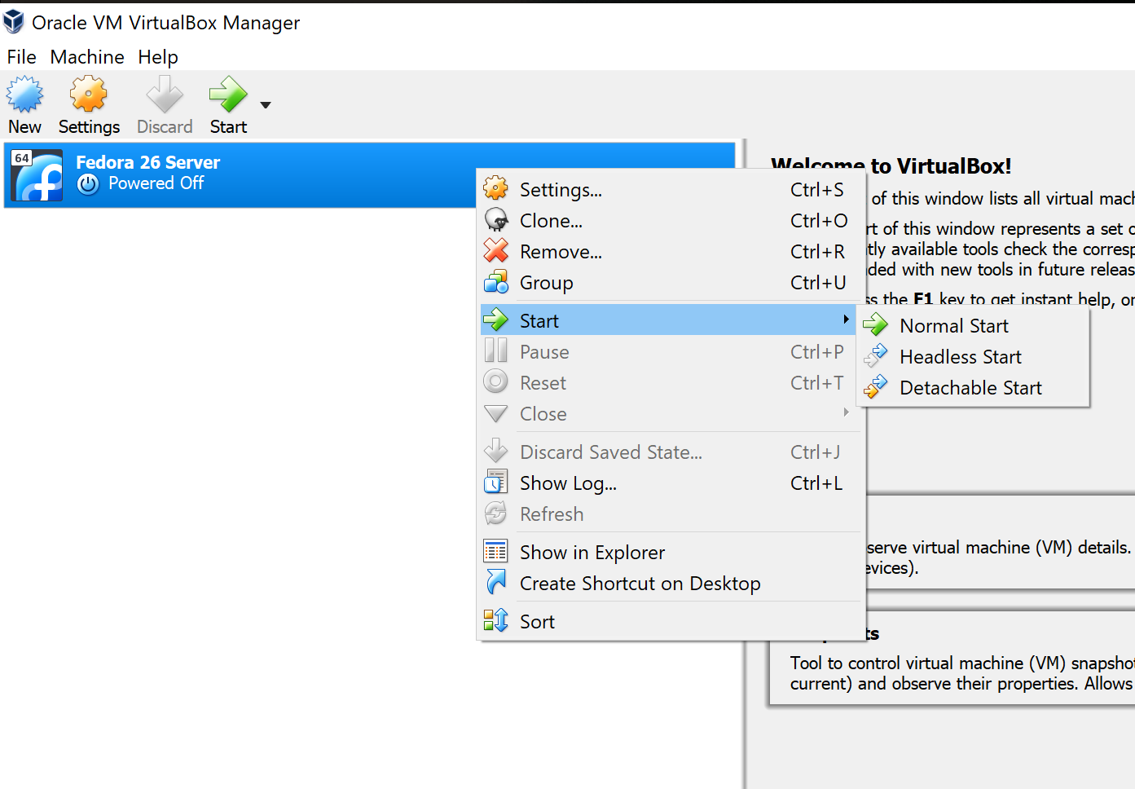
Power Up Ubuntu Server
or

Slide 22
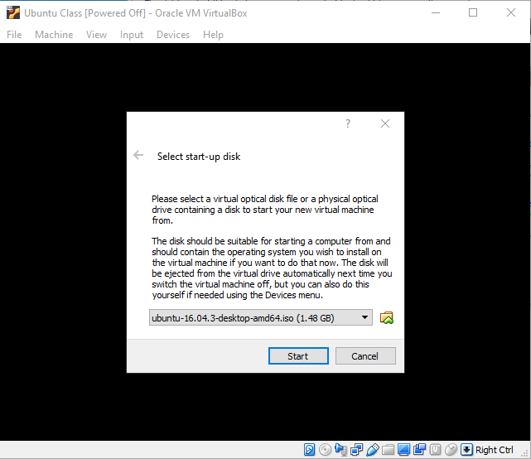
Select Ubuntu Image (ISO)
You will mostly be in ‘shell’ mode, e.g. you won’t use the GUI much. The reason for the desktop version is to enable you to upload assignments using the ‘Firefox’ browser.
Go to:
1. Desktop
2. Select ISO’s
Select the Ubuntu
desktop version
2. Press ‘Start’

Slide 23
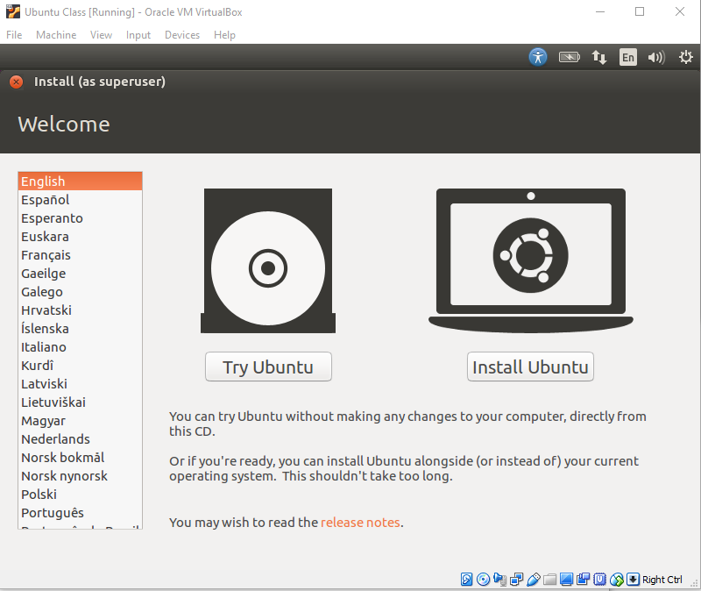
Install Ubuntu Desktop Linux
You’ll see a black screen for awhile then the words ‘Ubuntu’ and the version number.
You may be asked to update to a newer version – DO NOT UPDATE on the lab computers as you will have to start over.

Slide 24
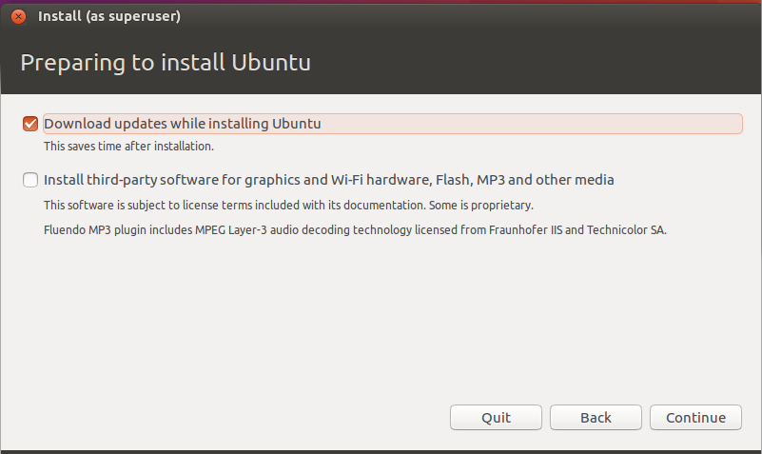
Preparing to Install

Slide 25
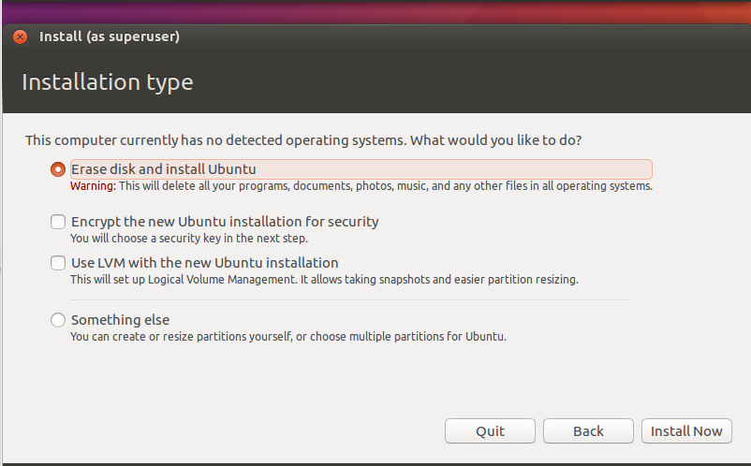
Installation Type

Slide 26
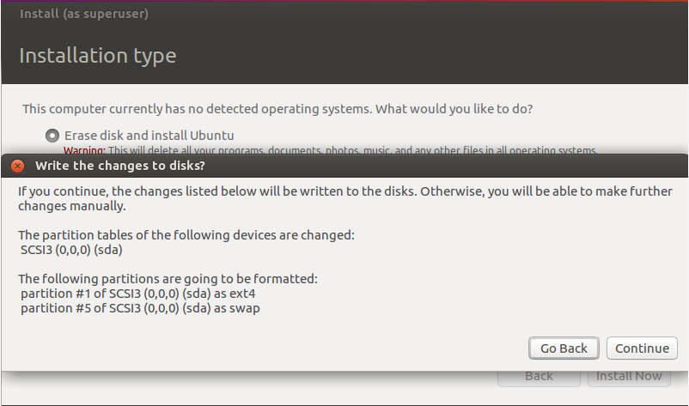
Write Changes to Disk
Now you wait until the install is completed.

Slide 27
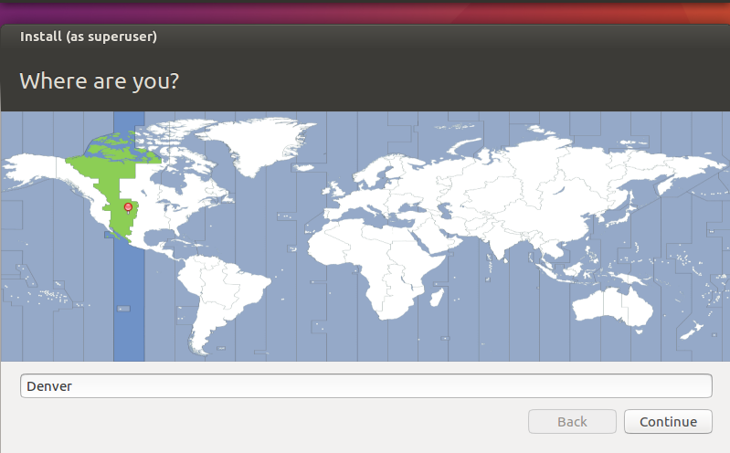
Location
Wait some more…

Slide 28
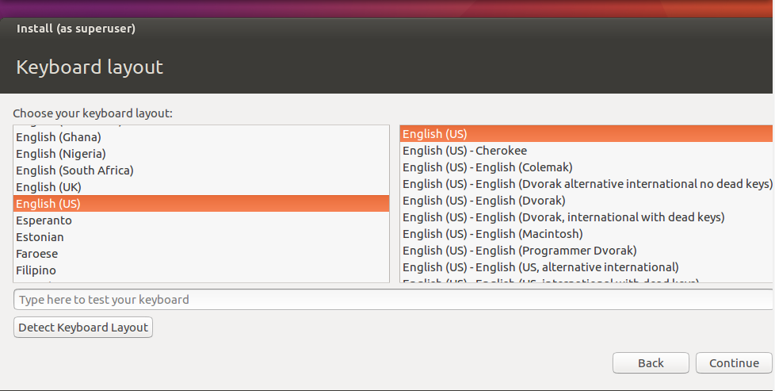
Keyboard Layout
If you do not see the ‘Continue’, press <TAB> until you do.

Slide 29
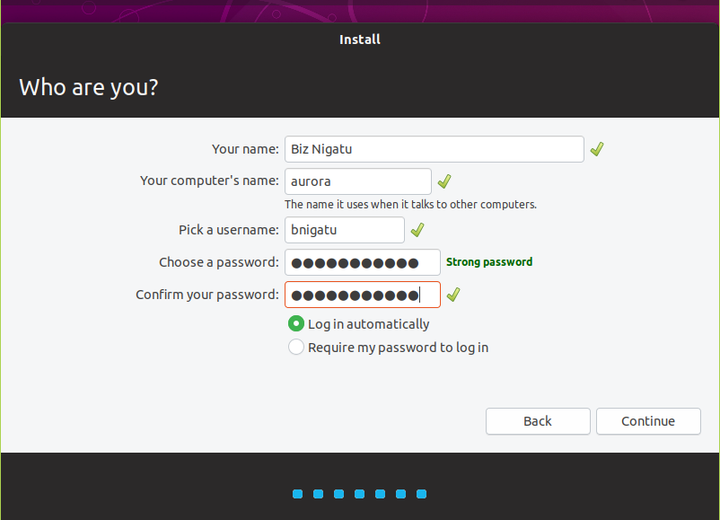
Your Information
Wait some more…

Slide 30
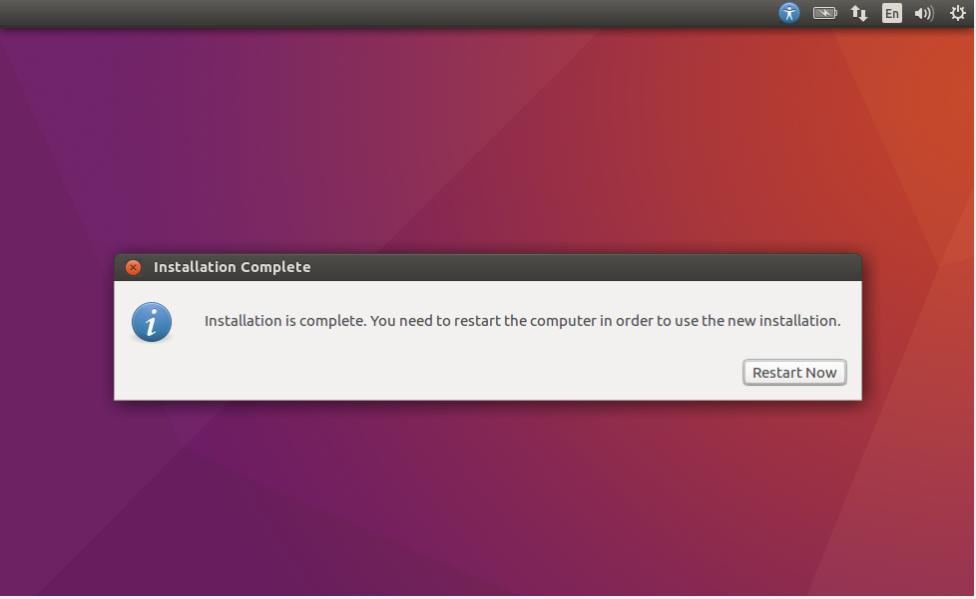
Restart

Slide 31
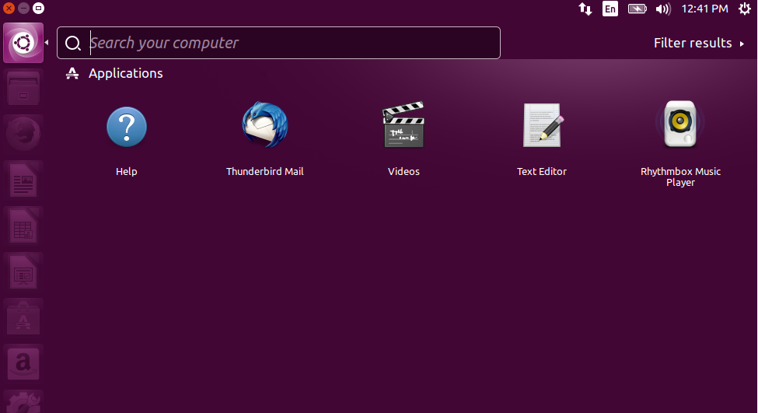
Install Terminal

Slide 32
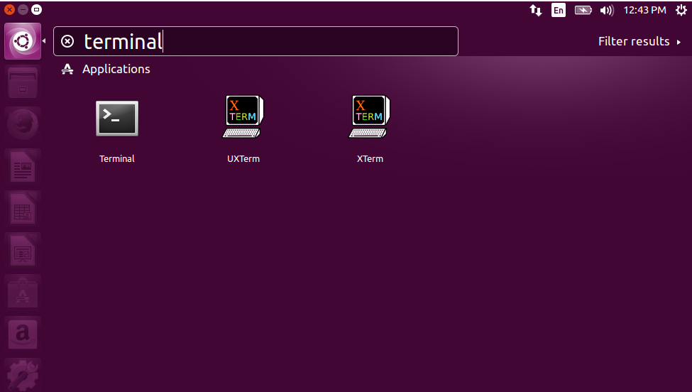
Install Terminal

Slide 33
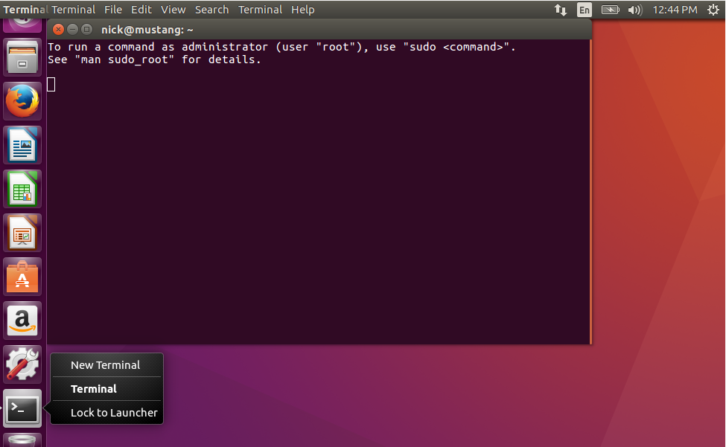
Lock Terminal to Launcher
Right click on terminal icon

Slide 34
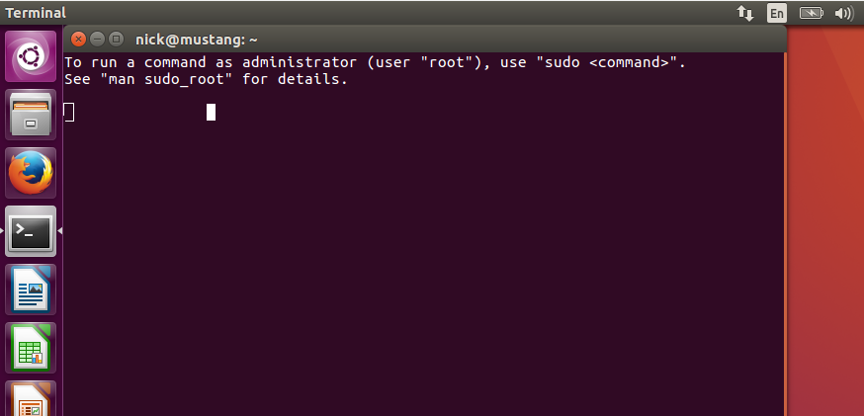
Move Terminal Icon
Put mouse pointer over terminal icon
Left click and drag terminal icon to under Firefox

Slide 35
‘passwd’ Command
$ passwd <username>
System prompts for old password
System then prompts for new password
System then prompts for new again
If change occurs no message appears
= UNIX Principle: No news is good news

Slide 36
Login Failure
A login failure will generate a login error which must be acknowledged
If login does not exist
Screen will be cleared and a new login screen generated
If login does exist, but password is incorrect
Only the password entry is cleared
The cursor is positioned for a new password attempt.
After a certain number of tries, screen is cleared or system quits talking to you

Slide 37
Login Failure (cont)
Frequently a login will look correct, but is not
It may contain a leading space or tab which are difficult to see
If login continues to fail after several tries …
Contact instructor, then system administrator.

Slide 38
Successful login
If you see the $ prompt – you’re in
System is now ready to accept commands

Slide 39
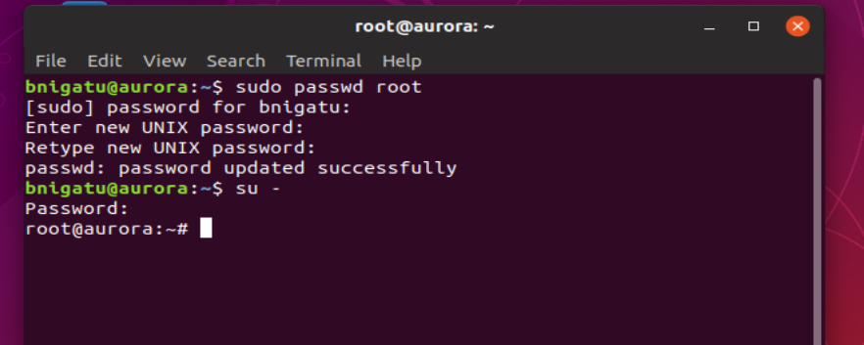
Configure Root
At this point, you need to setup a root password
type the following: sudo usermod root –p password; sudo passwd root;
Switch user

Slide 40
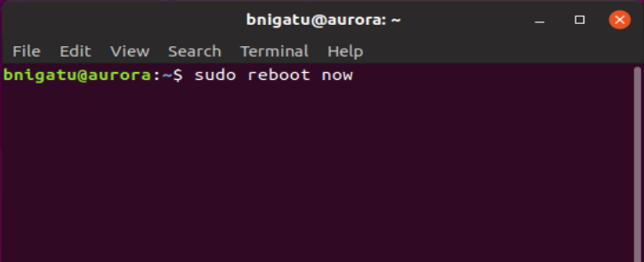
Performing a System Restart

Slide 41
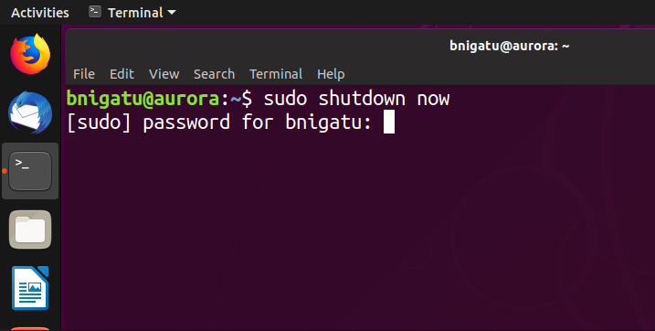
Performing a System Shutdown
Use your system password

Slide 42
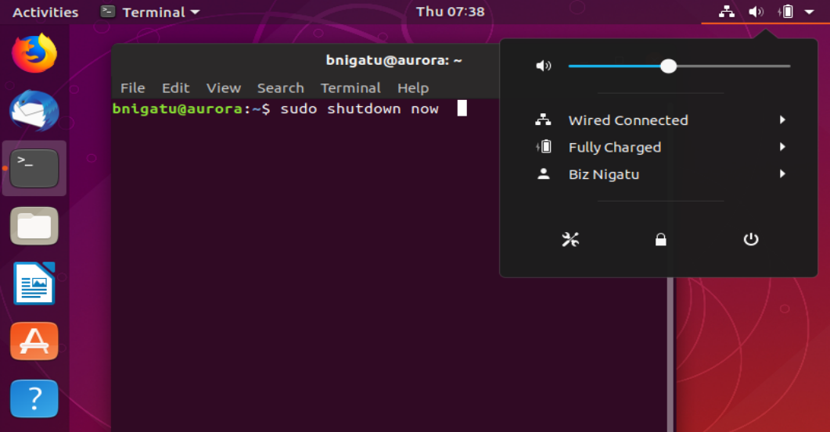
Performing System Shutdown

Slide 43
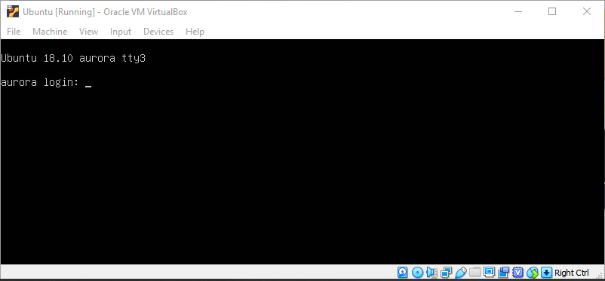
Login to TTY
Press CTRL+F2 to F6

Slide 44
Logging Out with ‘exit’
To log out of a system, type ‘exit’
Clean way to leave a Unix session
May be used to set a return status
Can be used to stop processing a shell script then the return status will be important to you
You can also exit using ‘<CTRL D>’ – not the preferred way
Once you’ve logged out, you can shutdown your virtual machine (VM) by clicking on the upper right ‘x’ of the window and selecting ‘power off machine’ – see next slide

Slide 45
INSTALLING VIM

Slide 46
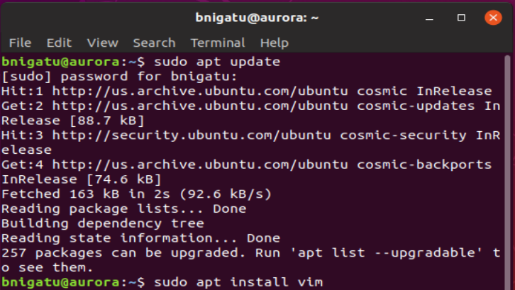
Installing VIM (VI iMproved) on Ubuntu
Step 1: Update the package list ‘sudo apt update’
Step 2: Install full version of vim ‘sudo apt install vim’
Step 3: Test it out – ‘vim test’
Step 4: To exit, do:
<shift> zz

Slide 47
On Home System Installing the Oracle VirtualBox and the Extension Packs

Slide 48
Current VirtualBox (VB) – for Home
The current version of VB is 5.2.26
You can get it here: https://www.virtualbox.org/wiki/Linux_Downloads
Follow the same process as used here in class; however, you can choose the server version or the desktop version with KDE already installed (see next slide)

Slide 49
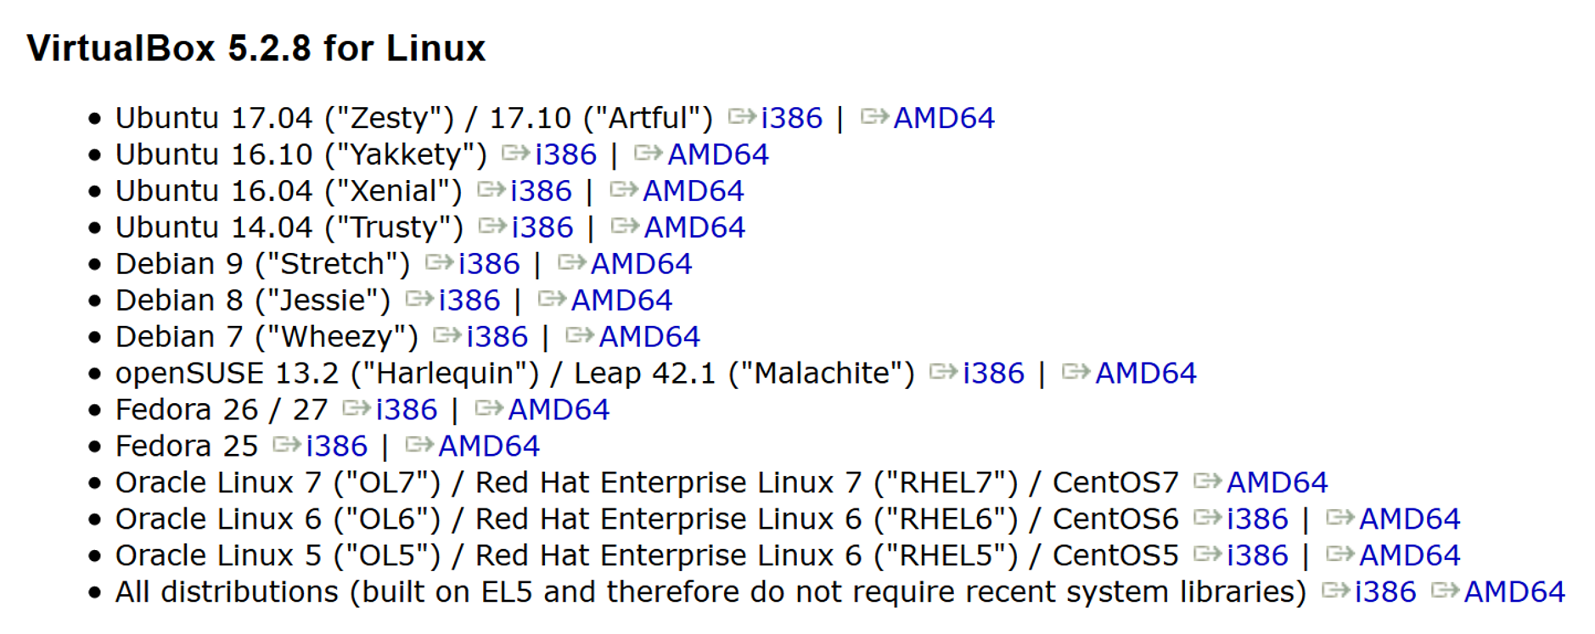

VirtualBox Editions
server
desktop
Fedora is Red Hat

Slide 50
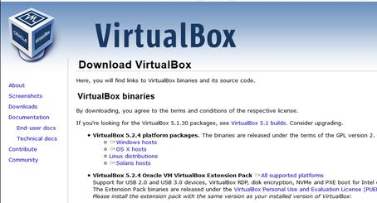
Download the Extensions Pack
Go to: https://www.virtualbox.org/wiki/Downloads (5.2.12 - current)
Download (see red arrow)

Slide 51
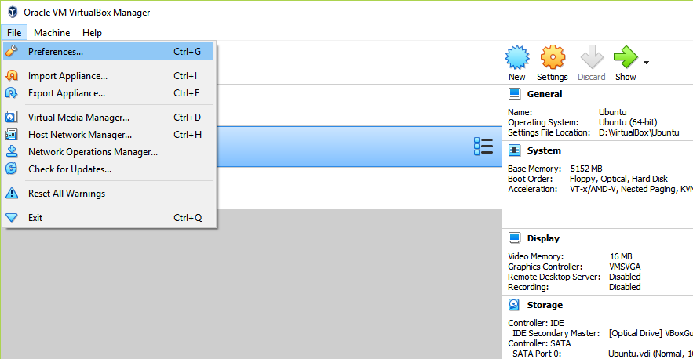
Add VirtualBox Extension Pack
Step 1: Make sure all VMs are powered off
Step 2: Click on ‘File/Preferences’

Slide 52
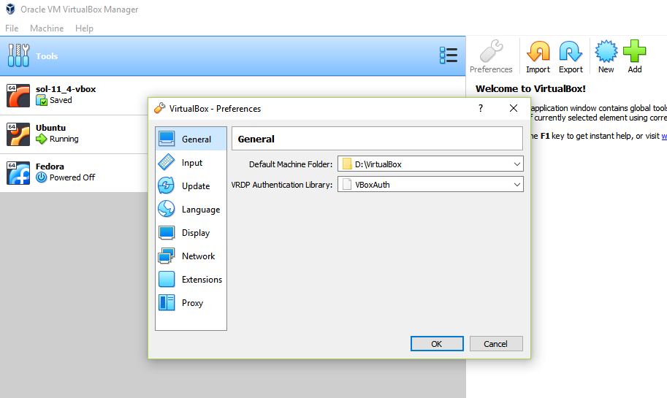
Add VirtualBox Extension Pack
You will see this:
Click on ‘Extensions’

Slide 53
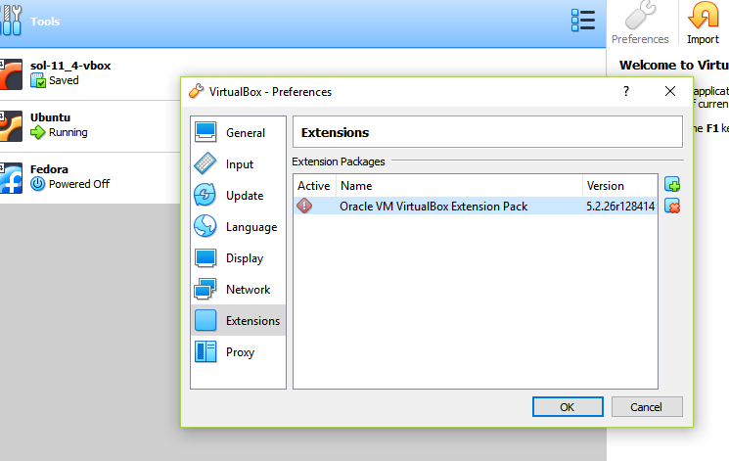
Add VirtualBox Extension Pack
Press the green ‘+’ button (see red arrow)
Go to wherever you placed the extensions and select the extension pack
Press ‘OK’

Slide 54
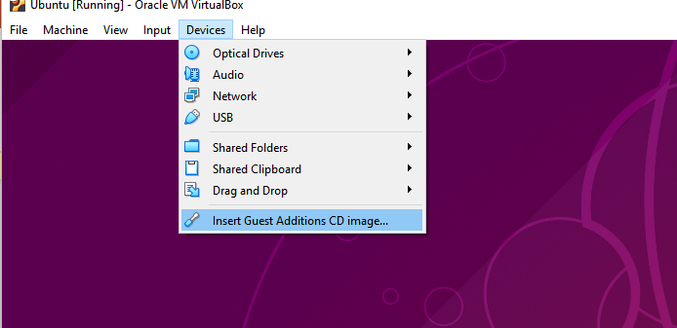
Insert Guest Additions CD
Click on the Guest Additions CD Image and you should get a box that comes up and that’s it.
Don’t do this until you have fully installed the guest OS.

Slide 55
Sharing Windows Folders

Slide 56
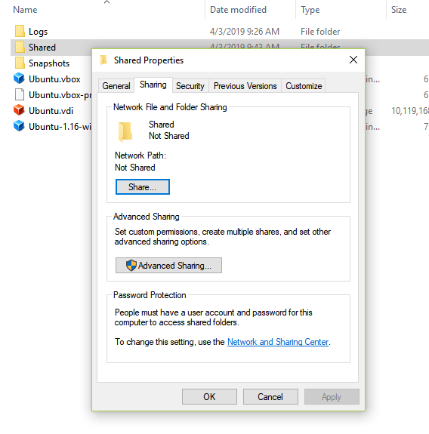
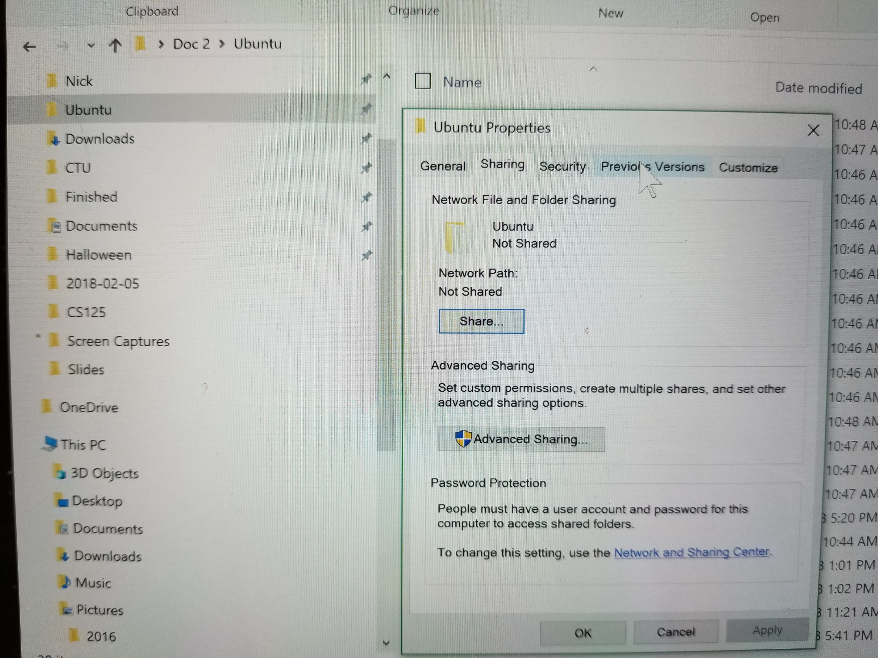
Step #1
right click
click
click

Slide 57
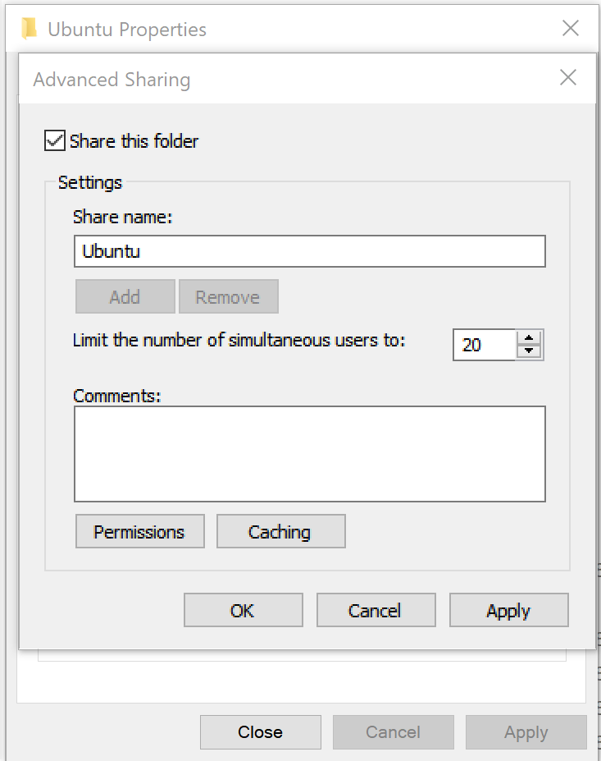
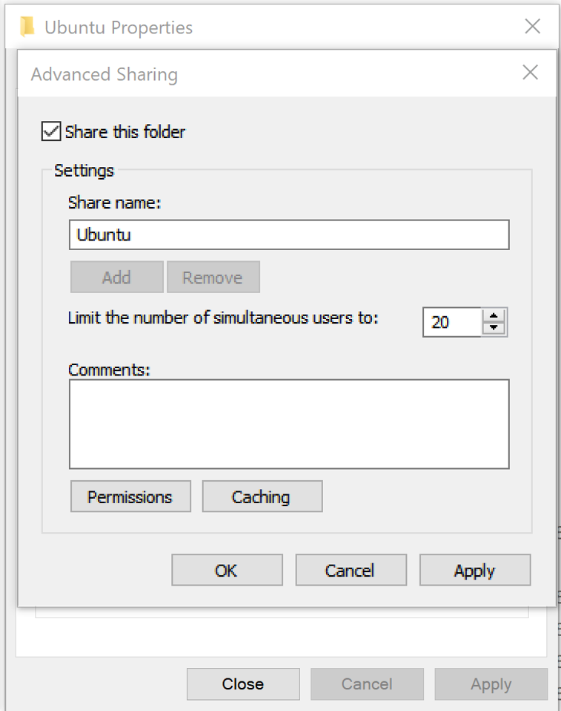
Advanced Sharing
Check - 1
Check - 3
Click - 2

Slide 58
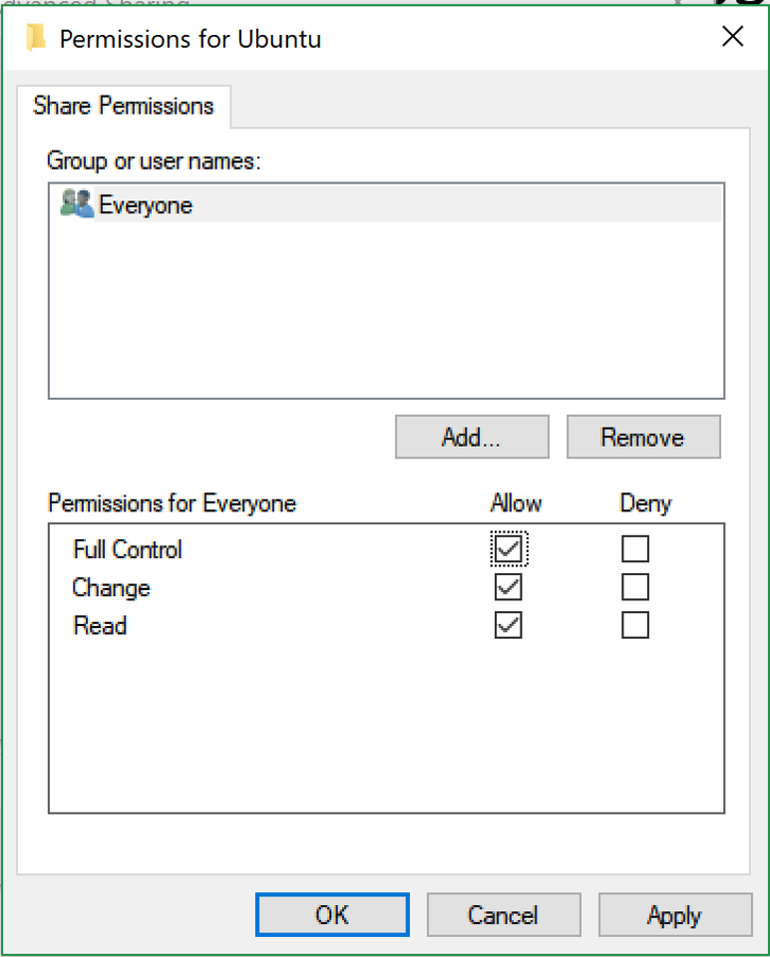

Permissions
Check ‘Full Control’

Slide 59
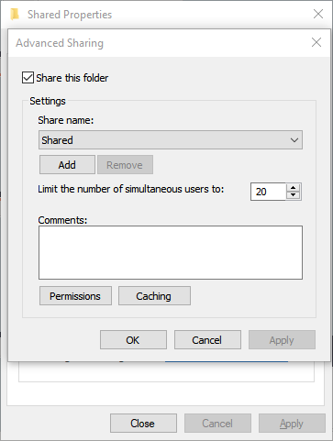
Caching

Slide 60
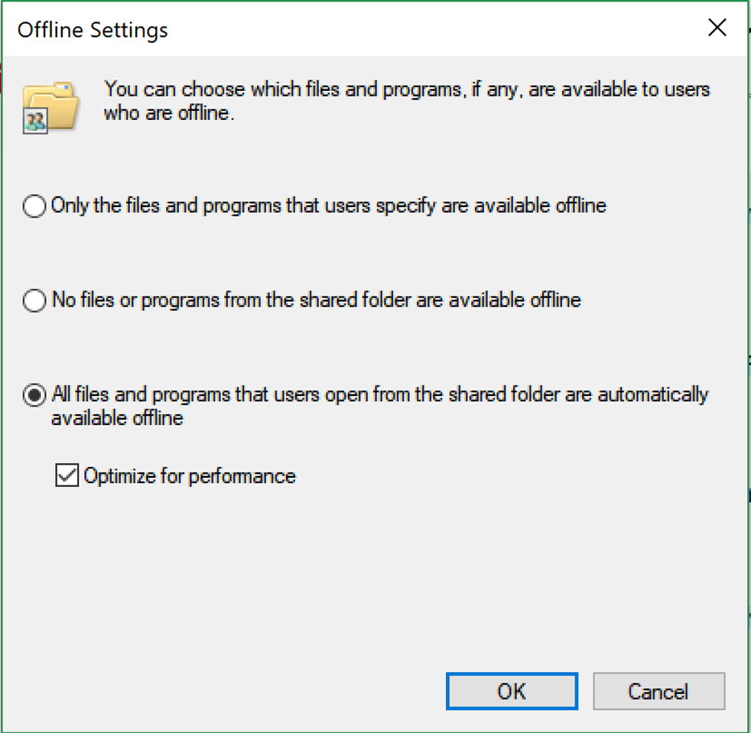

Caching
After this, type in your terminal window:
‘sudo shutdown –r now’

Slide 61
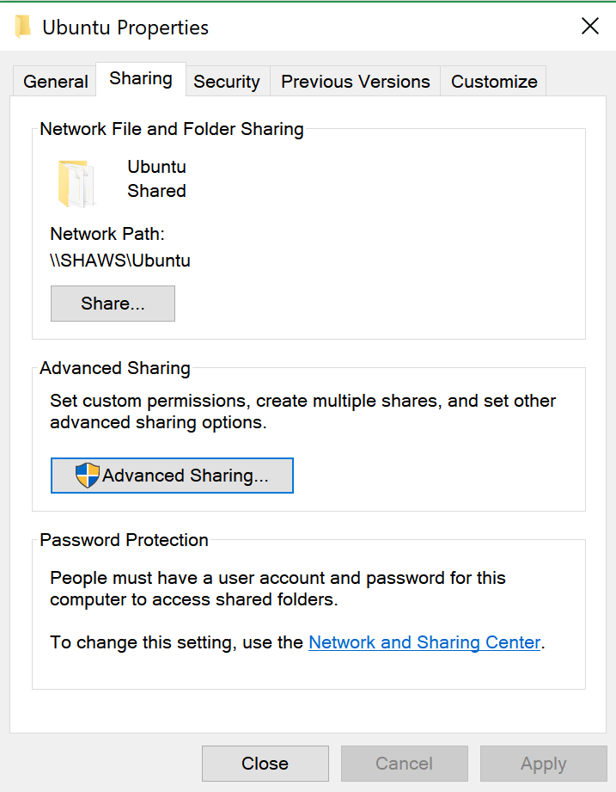
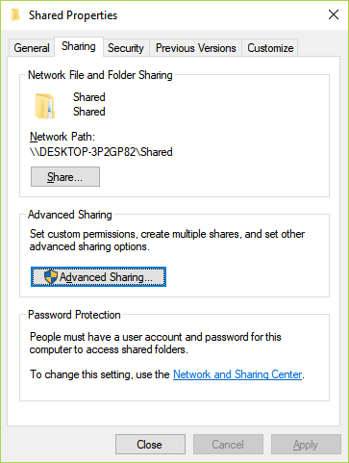
Close Out

Slide 62
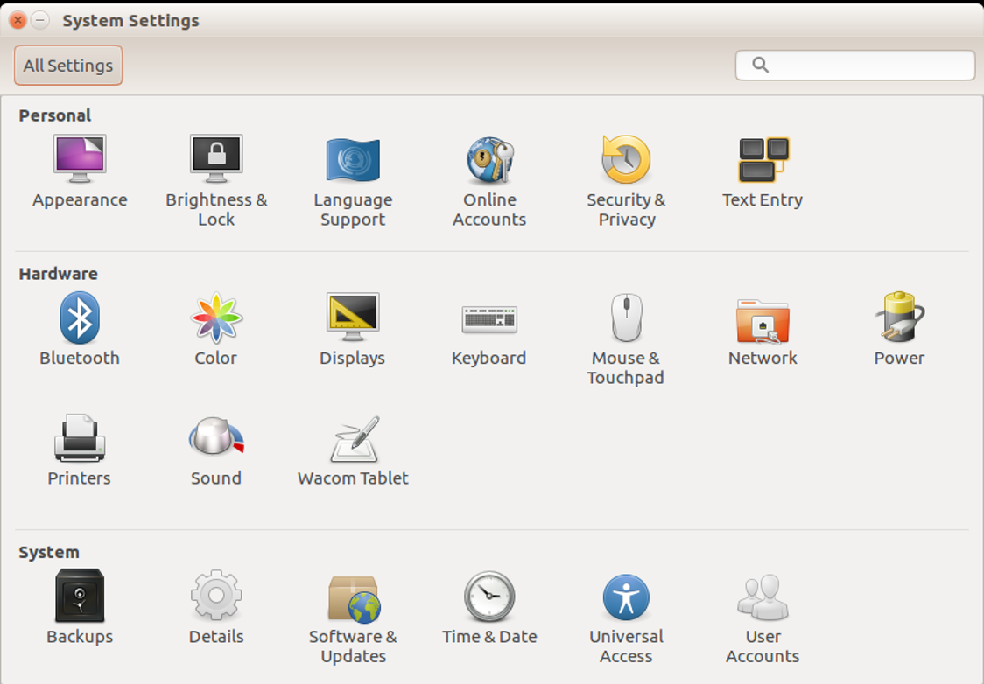

Configuring Delay Before Lock
Go to ‘System Settings’
Open ‘Brightness & Lock’

Slide 63


Brightness & Lock
EXIT

Slide 64


Configuring Autologin (Ubuntu 18.10.x)

Slide 65

Settings/Details

Slide 66
Reboot Ubuntu
Type the following: ‘sudo shutdown –r now’
‘-r’ means reboot

